Slide 1
GREEN v2
K8s education MVP
Abdoul Gadiri Diallo
Frederic Dutheil
Rory O'Grady
Vann Lam

Slide 2
Project Context
Client requires CMS-as-a-Service
Drupal is the CMS technology of choice
With CMS-aaS we must provide a DevOps solution
End goal: To provide the fastest solution to get new content into Production

Slide 3
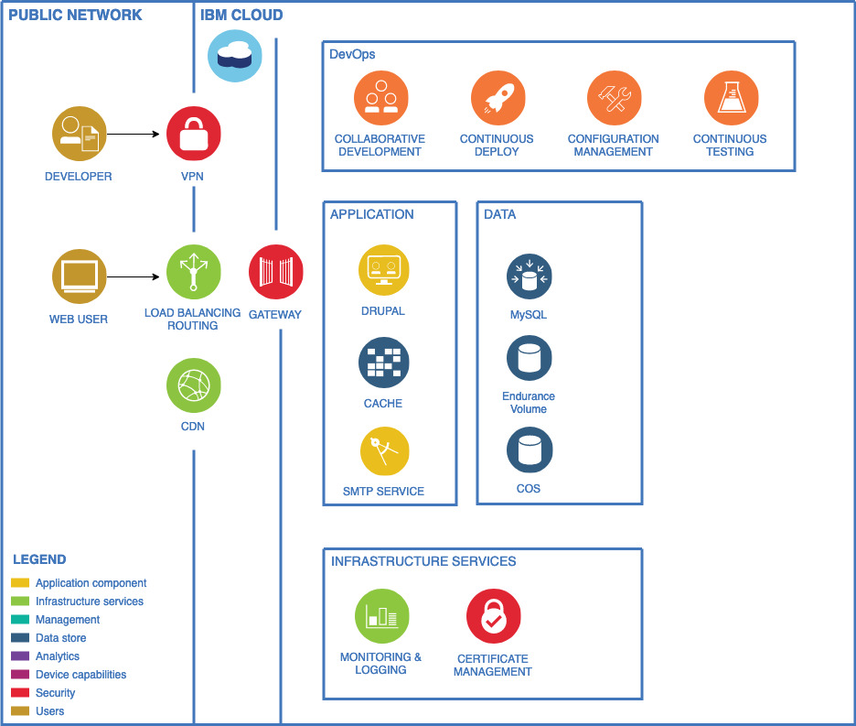
Logical architecture
Edge services provided
CDN for static content;
Cloud Internet Services
Application : Drupal Container
IBM Cloud
IAM for users/resources security management
IBM Kubernetes Service (IKS) for application components
Continious Delivery Service
Gateways for network security
Site administrators and Content Managers will access the site via a management VPN.
Endurance volume for persistence data (Drupal meta-data via MySQL)
MySQL database (used for its DbaaS Regional resiliency)
Cloud Objet Storage for static content and Regional resiliency
TLS Certificate management;
Notes:
Functional requirements
Separate environments for:
Dev/staging;
Production;
Site must be hosted on public cloud;
Site must be accessible globally;
Code deployment can be done using FTP/SFTP;
Content distribution using CDN;
SMTP setup to facilitate email communication to support “Contact Us” function in the website;
Non-functional requirements
Security:
Enterprise grade firewalling;
DDOS protection;
Availability:
High Availability of the infrastructure platform;
Scalability:
Scalable infrastructure with possible future expansion of the website.
Infrastructure support for services around DNS mapping and Certificate installation.

Slide 4



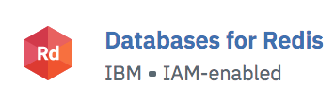



To do that … we used …
- Clusters
- Registry
IBM Toolchain

Slide 5
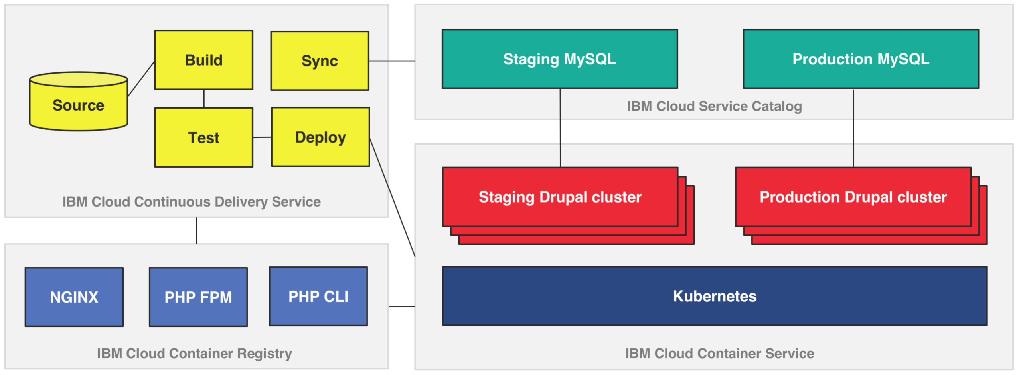
Landscape diagram of the services used
Notes:
Landscape diagram of the services used
When custom code is checked into this repository, it triggers a Docker image build which stores the images into a private container registry that analyzes the security of the images. These images are then rolled out across the Kubernetes cluster through staging and production gates. Data from production can be synchronized back to staging to ensure the environments are as close as possible.

Slide 6
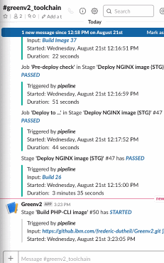
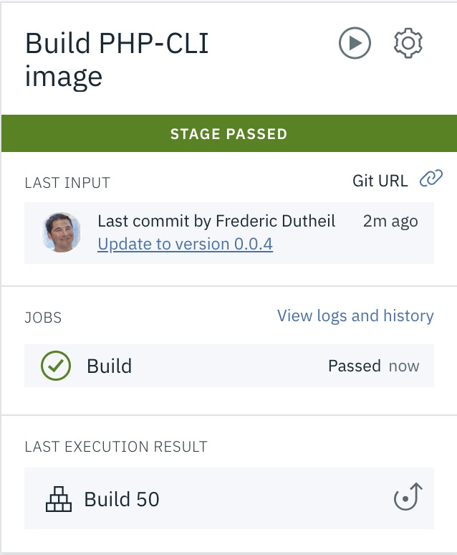
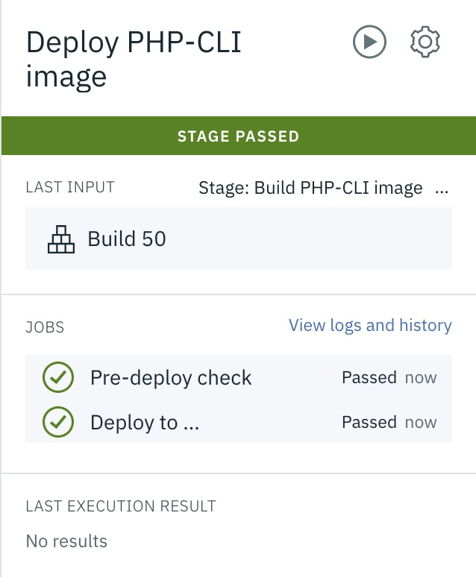
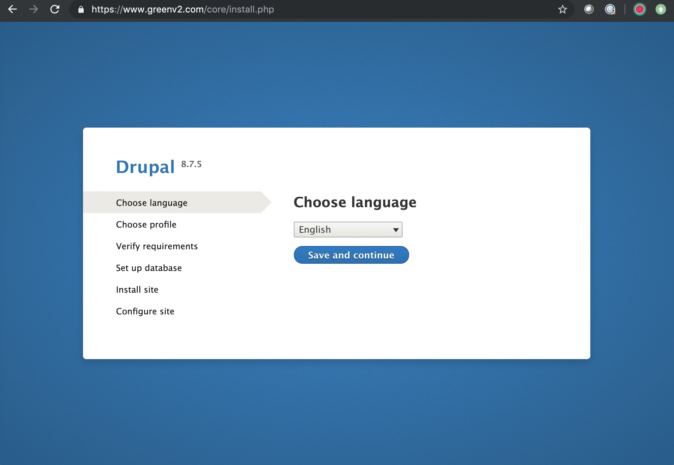
Create CMS Docker images
( Drupal, MySQL )
Deploy it to IKS
Update Code
Slack
notification
IBM Toolchain
CMS is available on
the target environment
www.greenv2.com

Slide 7
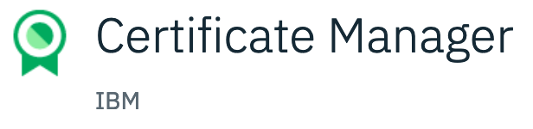
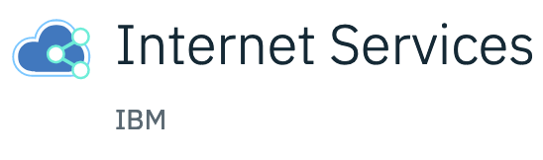



Domain Name Management
Caching
IBM Function(serverless) Service
New certificate
trigger
integration
www.greenv2.com

Slide 8
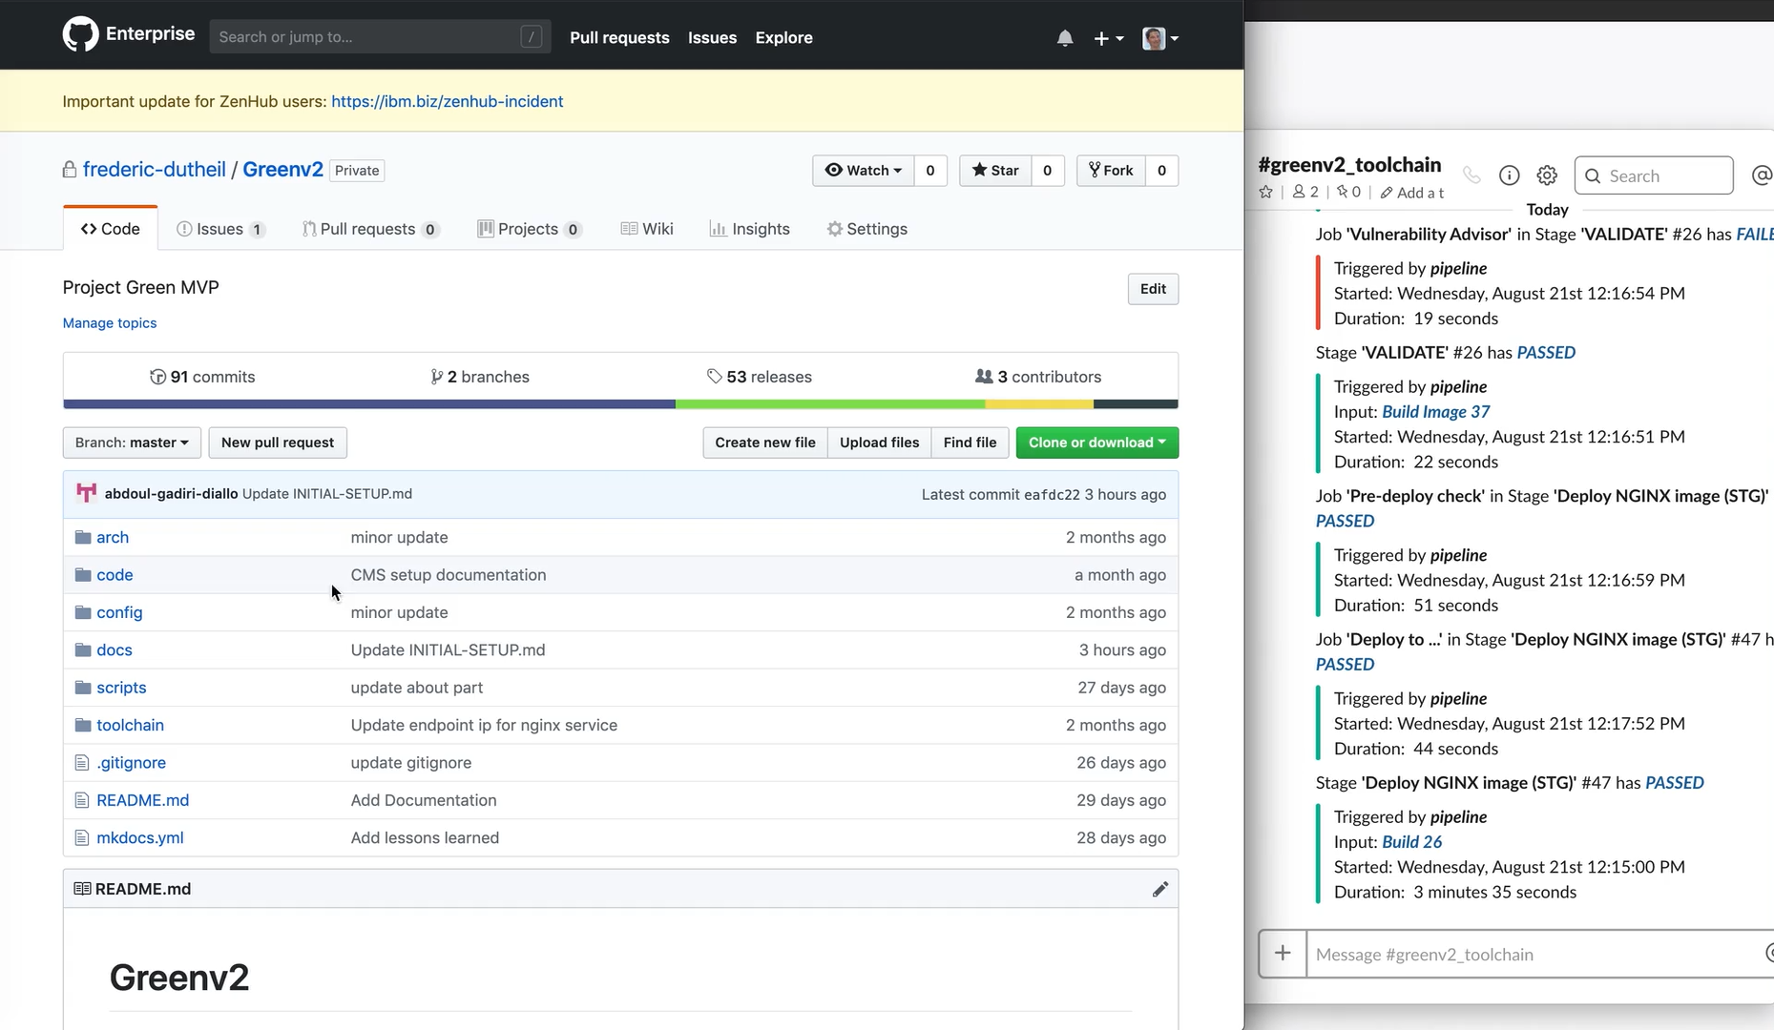
Toolchain video demo
Notes:
Landscape diagram of the services used
When custom code is checked into this repository, it triggers a Docker image build which stores the images into a private container registry that analyzes the security of the images. These images are then rolled out across the Kubernetes cluster through staging and production gates. Data from production can be synchronized back to staging to ensure the environments are as close as possible.

Slide 9
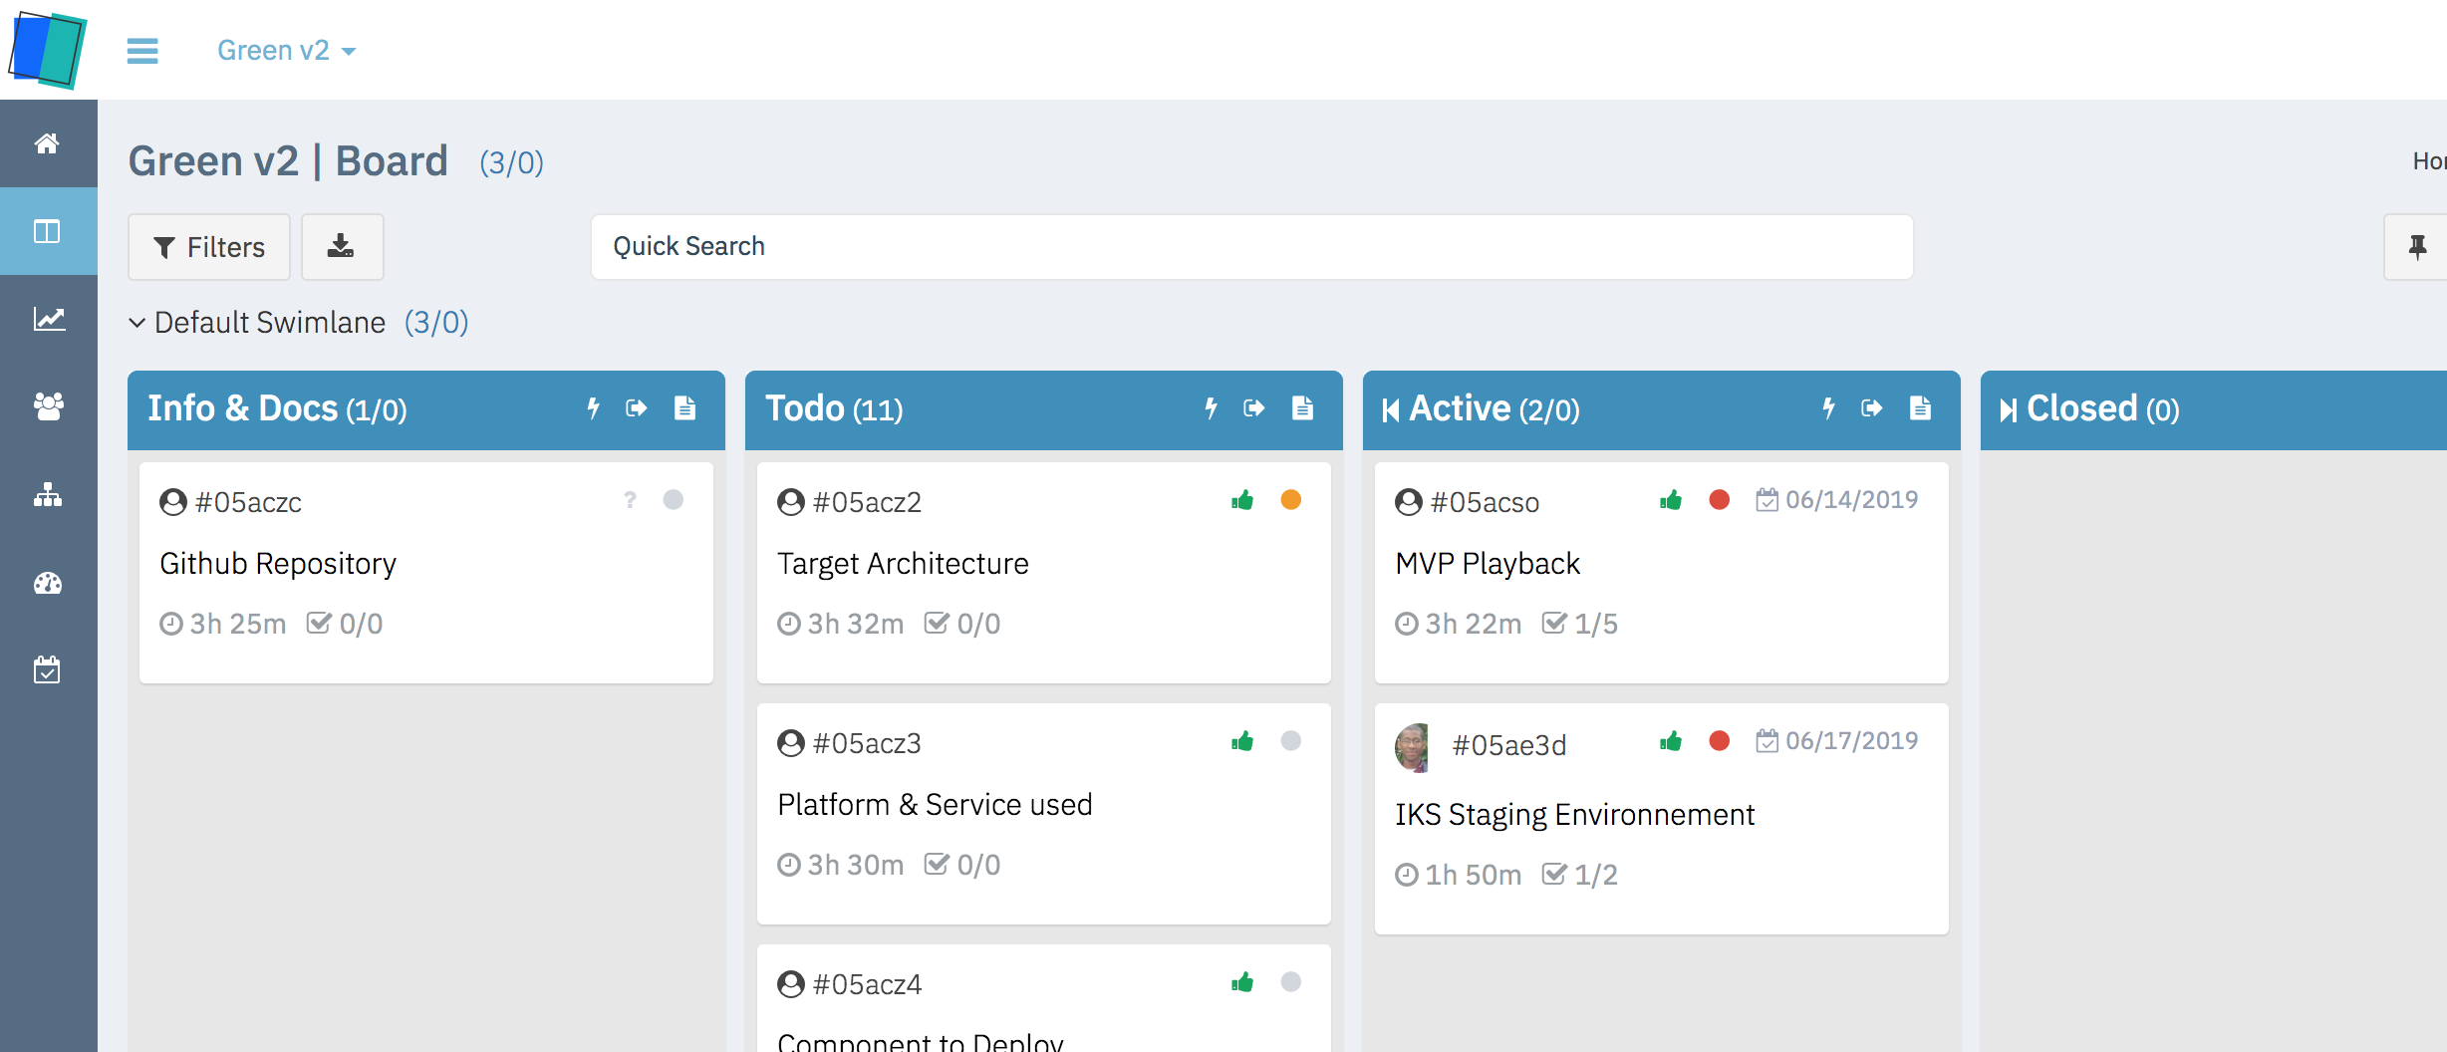
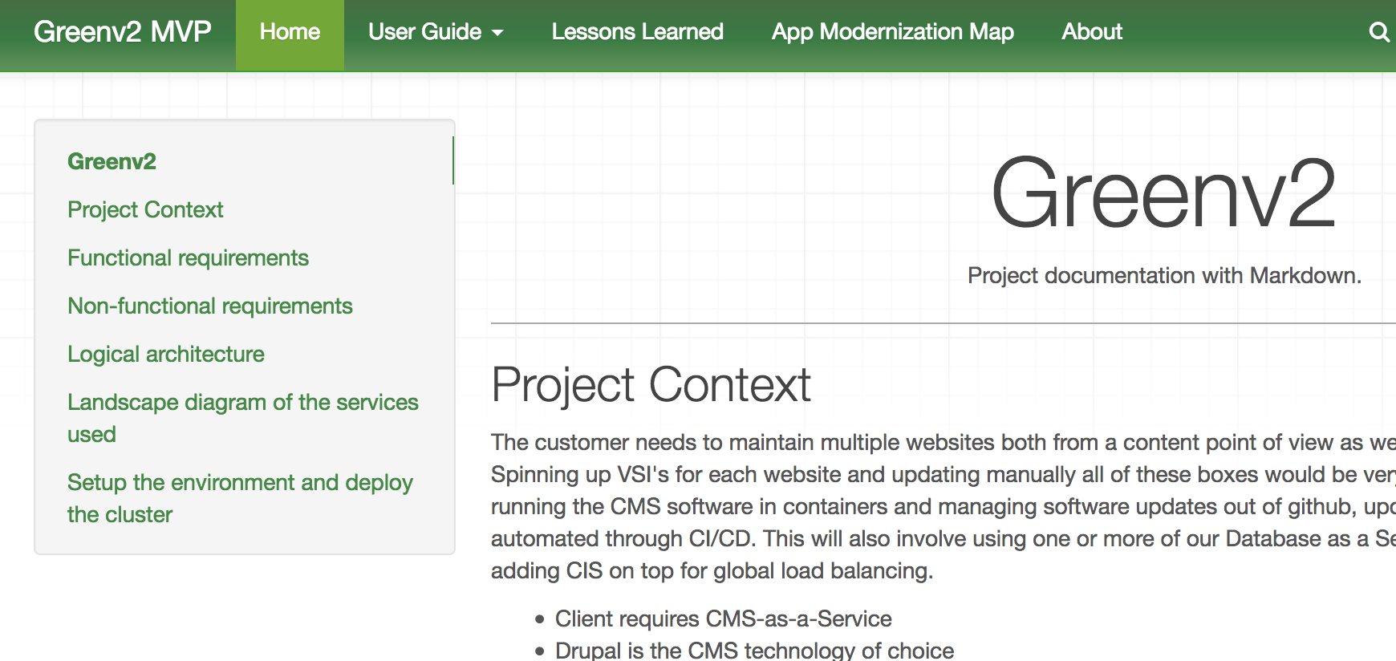
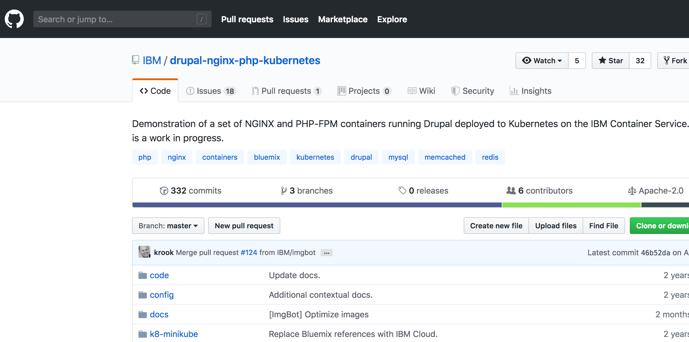
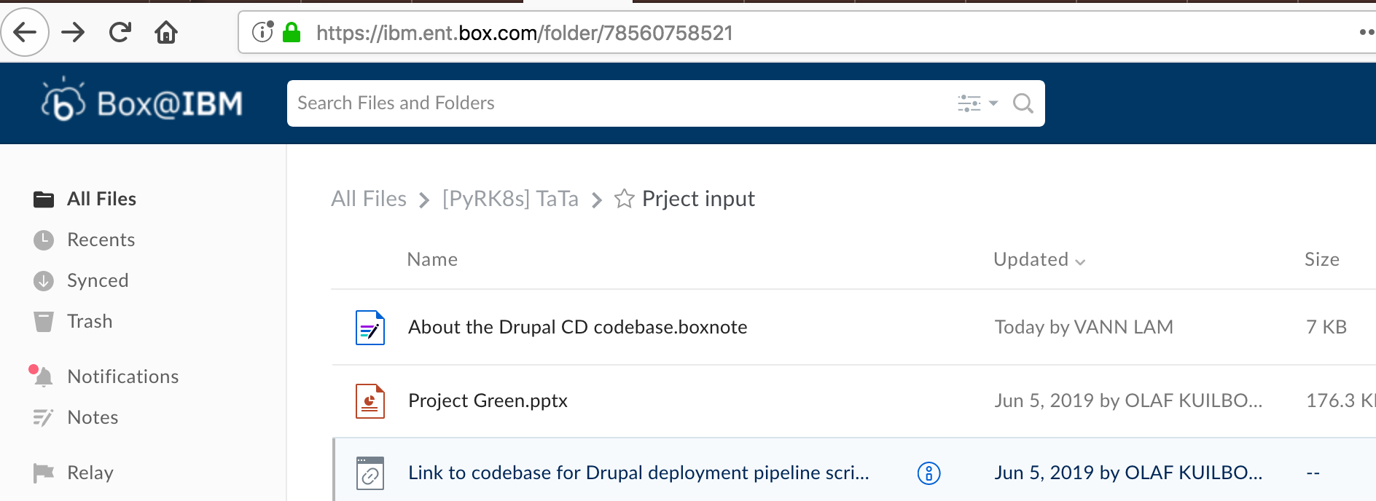
High level Project Planning and documentation

Slide 10


